Slide 1

Serverless image processing
Group -12

Slide 2

•Introduction​
•Architecture Overview
•Amazon S3 Buckets
•Lambda Function
•Benefits of Serverless
•Conclusion
Agenda

Slide 3

Introduction
A serverless image processing application is a cloud-based solution that automates the resizing and optimization of images when they are uploaded to an Amazon S3 bucket. This approach eliminates the need for maintaining dedicated servers, as the application relies on cloud services like AWS Lambda to perform the image processing tasks.

Slide 4

Architecture overview
The serverless architecture involves AWS Lambda functions triggered by events from Amazon S3 buckets.
This event-driven approach ensures immediate processing upon image uploads.

Slide 5

Amazon S3 Bucket
The purpose of the Amazon S3 (Simple Storage Service) bucket in the context of the serverless image processing application is to serve as a central storage location for both the original and processed images.
It acts as a durable and scalable repository that enables seamless uploading, storage, and retrieval of images.

Slide 6

Lambda function
Event-driven: Responds to events like HTTP requests or S3 uploads.
Languages: Supports Node.js, Python, Java, etc.
Create Lambda function: Define handler, code, configure triggers.
Deployment: Upload the code.

Slide 7

Benefits of Serverless
Scalability: Automatic scaling handles varying workloads without manual intervention.
Cost Efficiency: Pay only for actual usage, reducing infrastructure costs.
Simplified Development: Focus on code, not server management, for faster development.
Global Availability: Deploy globally for improved reach and availability, with reduced vendor lock-in.

Slide 8

Conclusion
In conclusion, serverless image processing using AWS Lambda and S3 is a powerful solution that offers scalability, cost-effectiveness, and ease of use.

Slide 9

Contributors :
Ameesha Sharma
Anushka Bajpai
Arman Siddiqui
Ayushi Srivastava
Shikhar Kashyap
Thank you

Slide 10


Slide 11


Slide 12
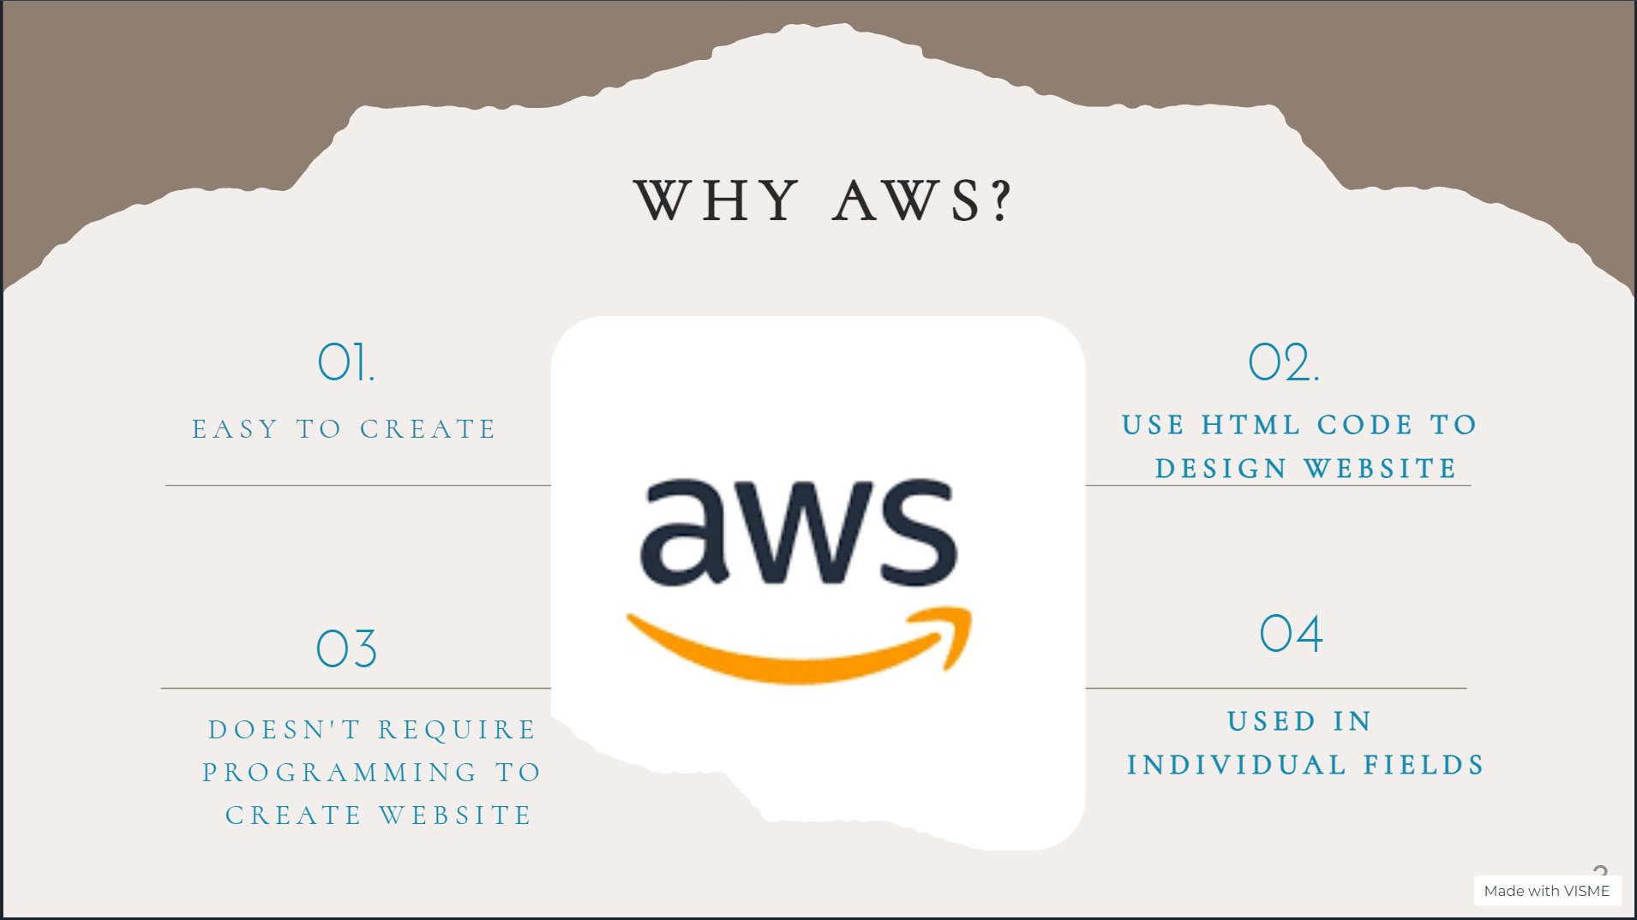

This Photo by Unknown Author is licensed under CC BY-SA

Slide 13


Slide 14
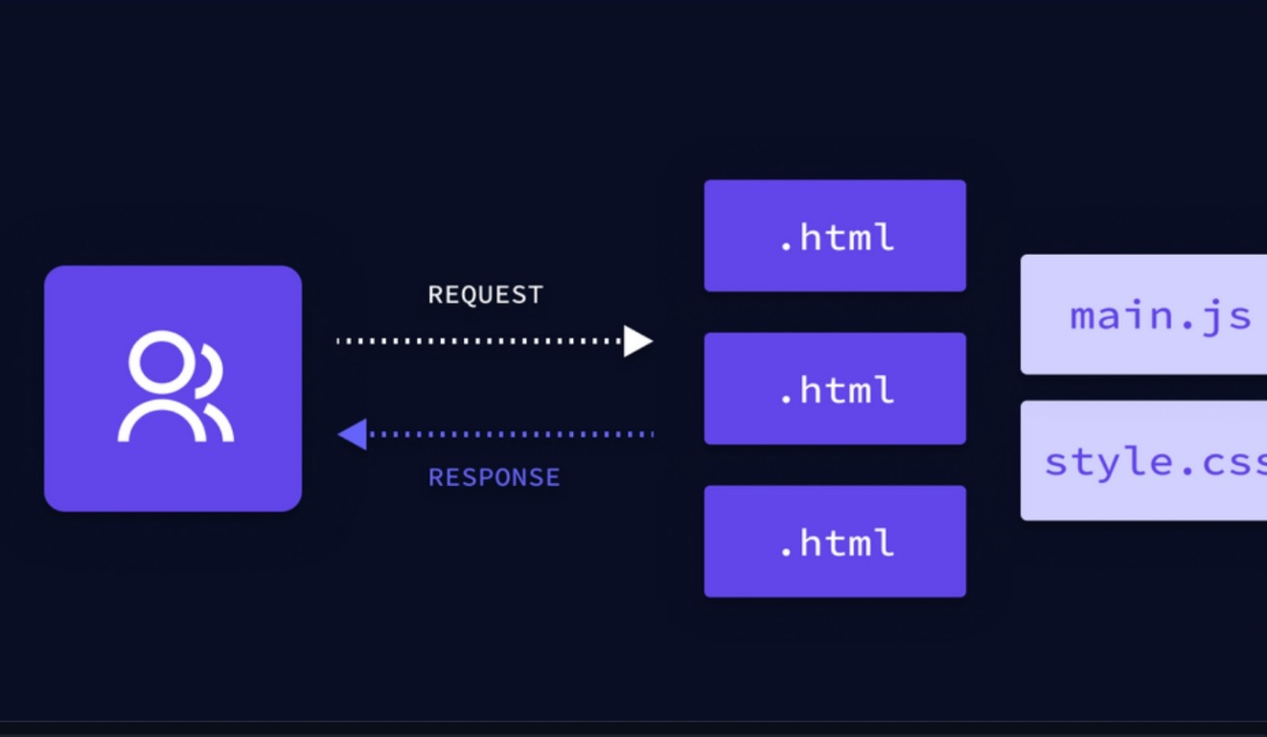

Slide 15
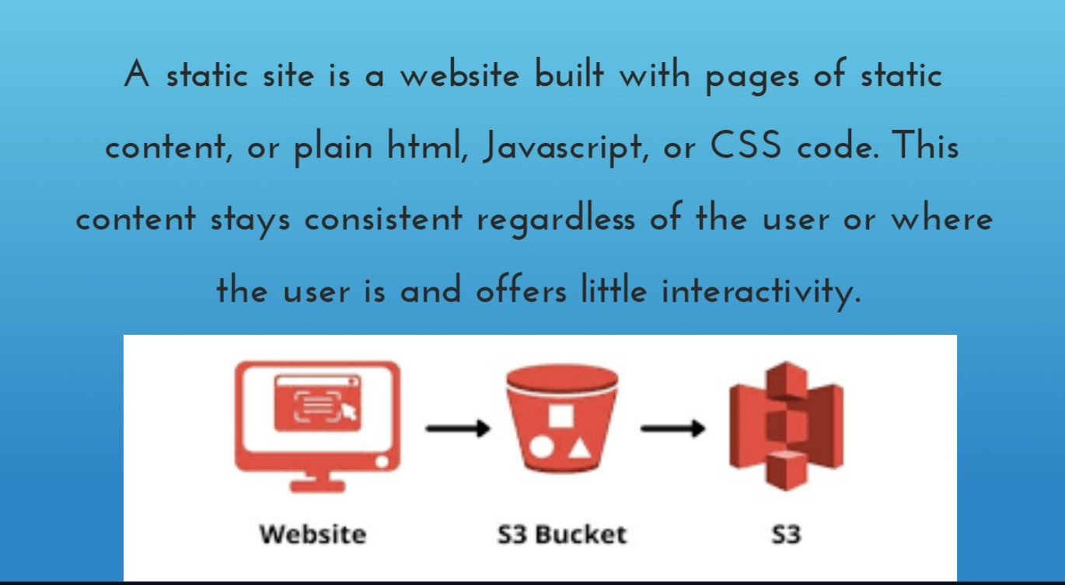

Slide 16


Slide 17
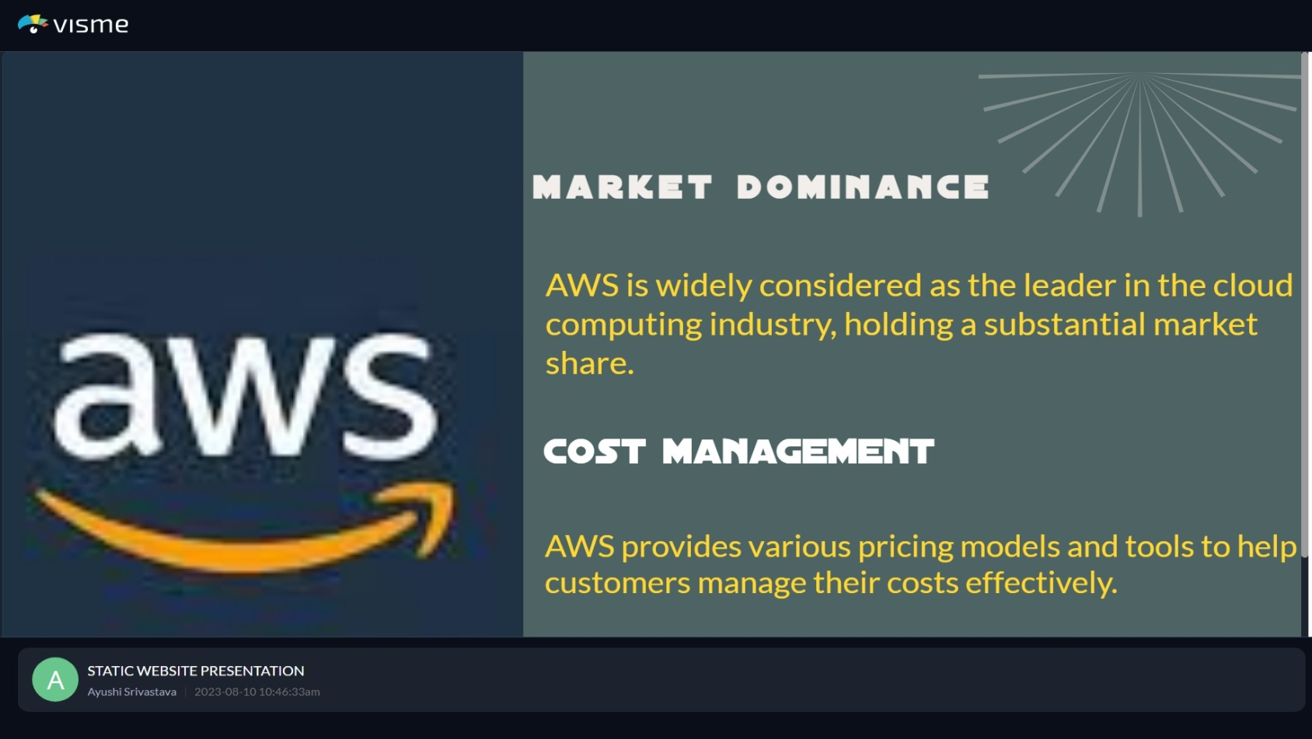


Slide 18
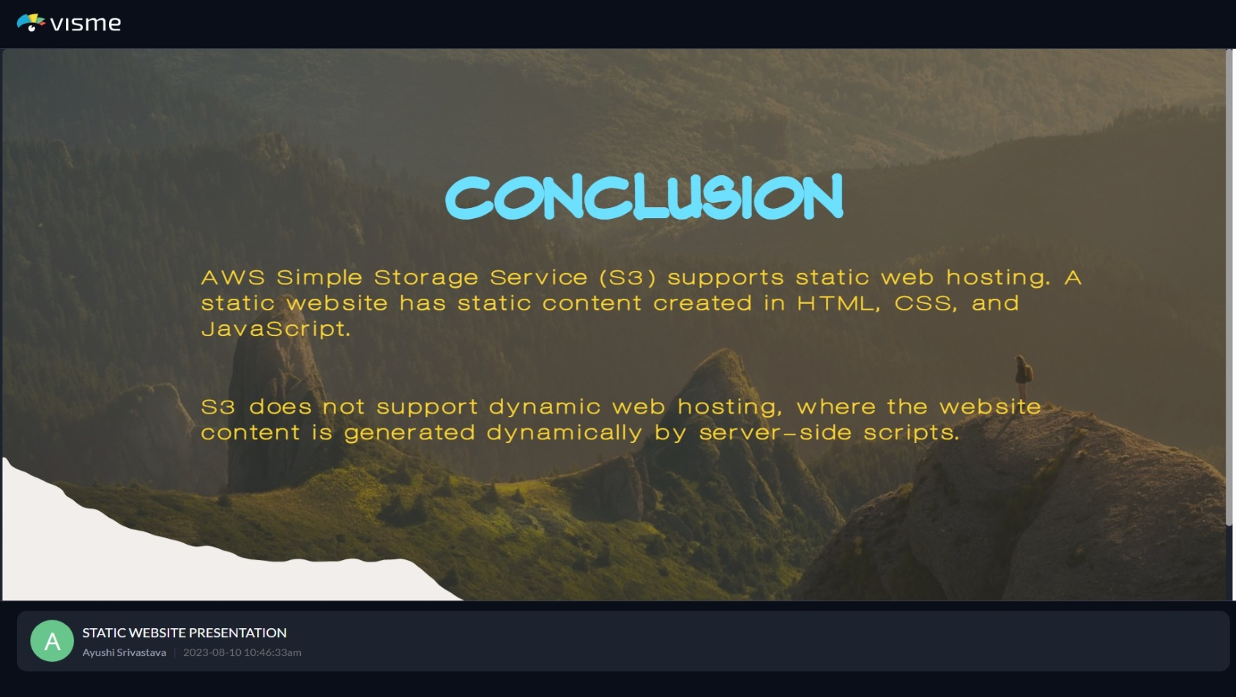

Slide 19


